Slide 1
Project Week
UofT Data Bootcamp

Slide 2
Group – Pursuit of Happiness
Eben Haezer
J Kurt Baltero
Momotaz Mahin Khan
Sheri Shojaie
Vivi Santosa

Slide 3
Topic
Does money buy happiness?

Slide 4
Datasets
To update
Eben
Suicide rate - United Nations Development Program (CSV): link - WHO mortality data (API): link
Depression and satisfaction scores - World happiness score (CSV): link - National depressive score, Global Change Data Lab (CSV): link
Economic health - GDP - United Nations Development Program (CSV): link - Unemployment and poverty – The World Bank (CSV): link
Secondary data sets to explore / consider - Search term trends (API) - link - Geolocation (API) - link
JKurt
Momo
Sheri
Vivi
Vivi
Sheri
Sheri
Sheri
Momo
Vivi
Eben
Eben
JKurt
JKurt
Sheri
Notes:
Tourism: International arrivals as an indicator for tourism (https://data.worldbank.org/indicator/ST.INT.ARVL)
Sleep: https://www.1843magazine.com/data-graphic/what-the-numbers-say/which-countries-get-the-most-sleep
Fun: https://travelskills.com/2013/03/14/top-10-countries-that-have-the-most-fun/

Slide 5





questions:
To update
Question #1:
Is happiness score (amongst country of interest) changing over time ?
Question #2:
Indicators of happiness score: interesting variables that could be correlated with happiness: Variables to look at: Note: data must be in the following timeframe: 2015-2019
Crime rate; alcohol consumption; depression; population age; education; suicide rate; access to health care; wealth disparity; recreation/fun, pets, tourism, gambling/casinos, sleep/rest, culture, religion
Question #3:
Why are people in certain rich countries (by GDP) less happy?
And why are people in certain poor countries (by GDP) more happy?
BONUS / next project: (search terms)
For a select country of interest (e.g. Canada), is happiness score correlated to Google Trend search? Are Indicators of World Happiness Report (Economy, Family, Health/ Life Expectancy, Freedom)
correlated to Google Trend search interests - ‘recession’, ‘divorce’, ‘death’, ‘protest’…?

Slide 6
Does money buy you happiness?

Slide 7
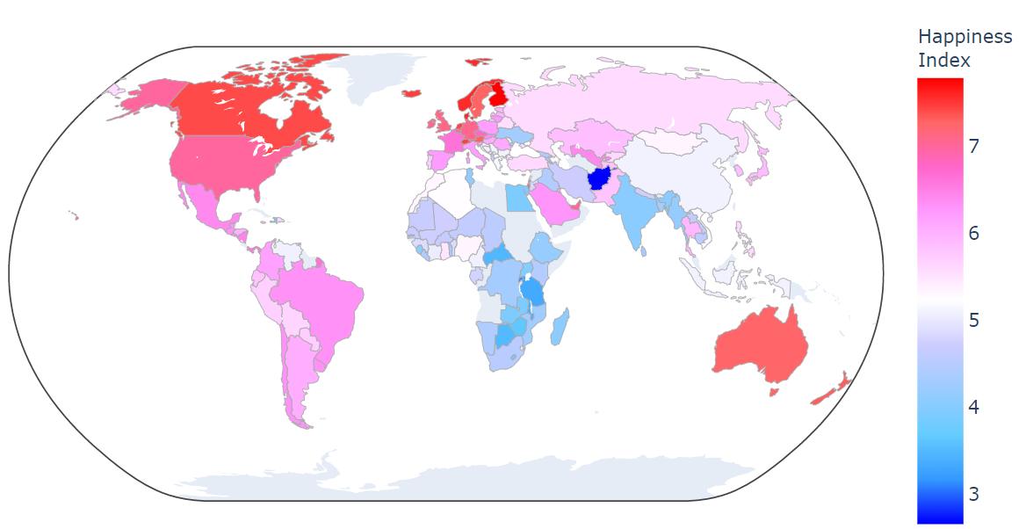
Question 1
Intro to happiness index
Show happiness index across the globe

Slide 8
What impact happiness? Does economic health impact the level of happiness?
H₀ = Economic health is not related to happiness
Intro to economic health variables:
GDP (maybe also median annual wage)
Unemployment
GINI Index

Slide 9
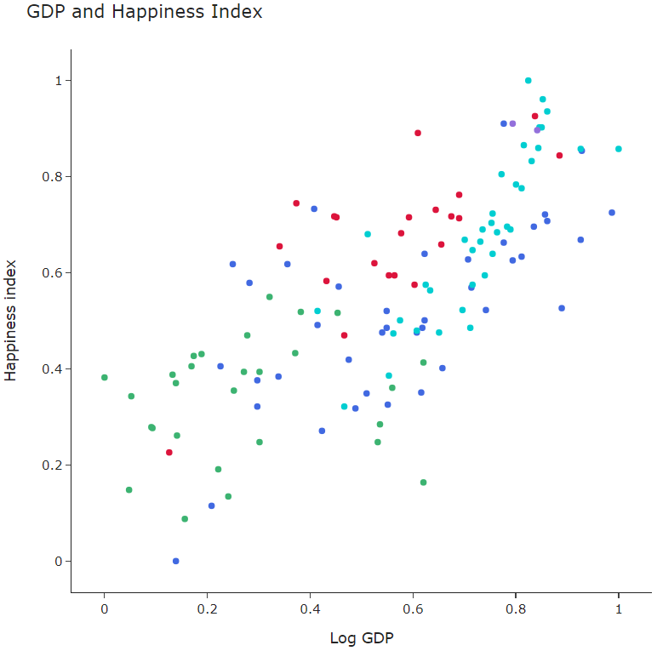
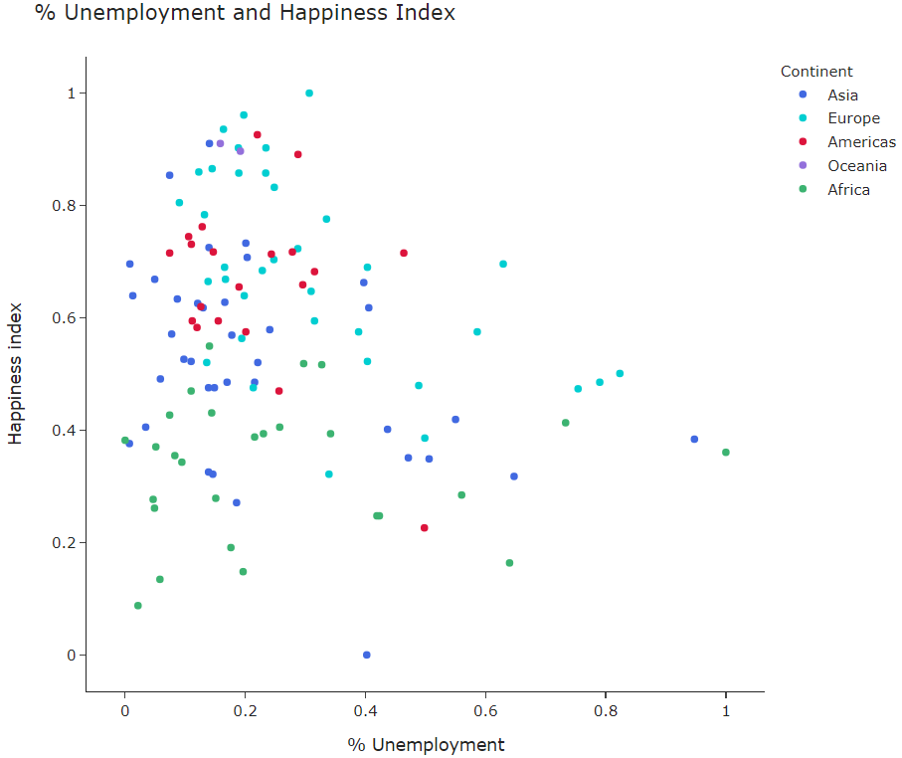
Question 2
Economic health and happiness index correlation (and outliers!)

Slide 10
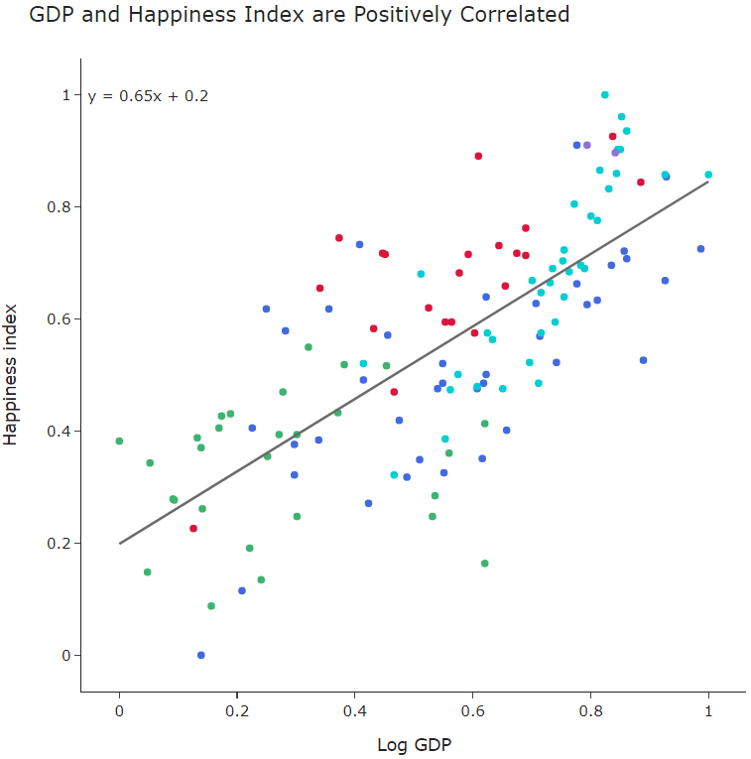
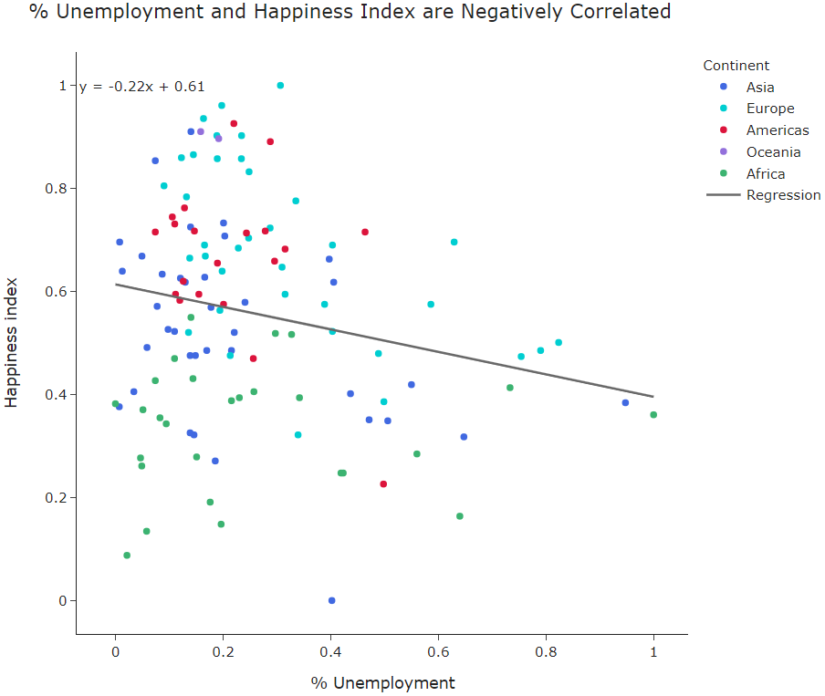
Question 3
Economic health and happiness index correlation (and outliers!)
Costa Rica
Nicaragua
Brazil
Spain

Slide 11
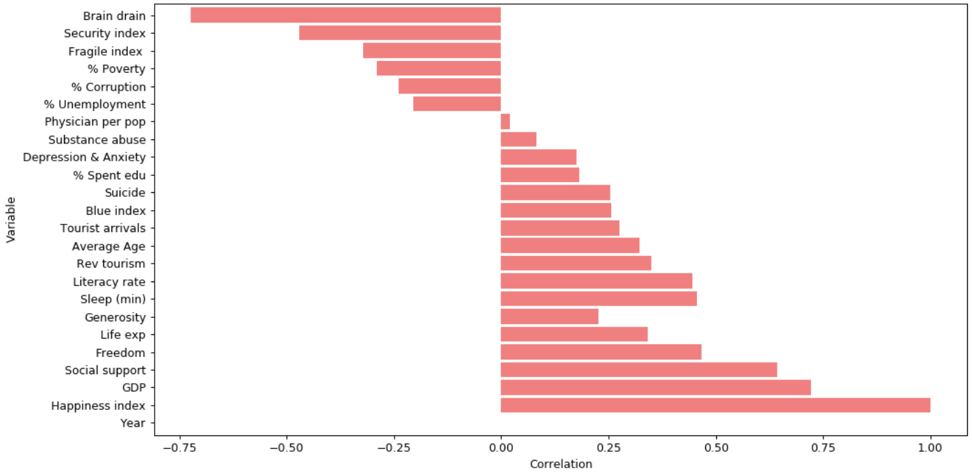
Question 4
What else makes people happy?
We looked at 23 variables (6 are from the index)
Negatively Correlated
Factors
Positively Correlated
Factors
Variables from the Happiness Index

Slide 12
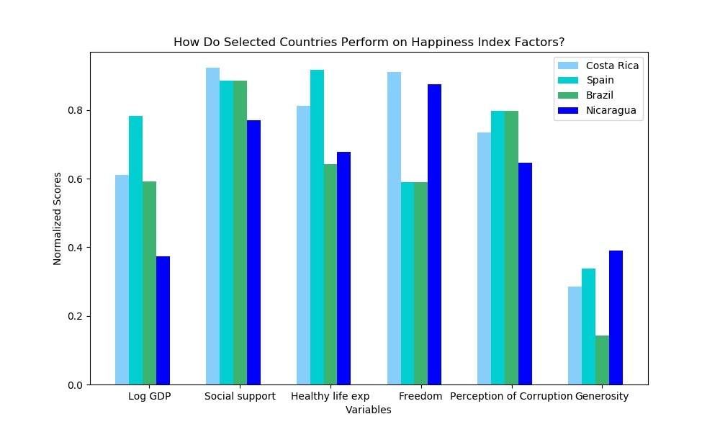
Question 5
How do our outliers look on these happiness variables?
Variables: (we need to pick 3-5 that are interesting)

Slide 13
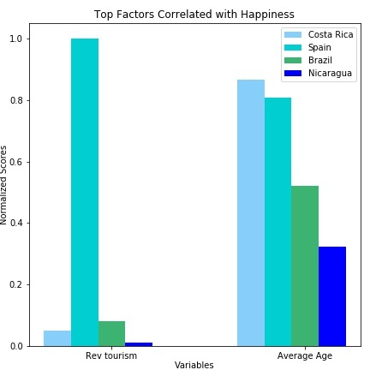
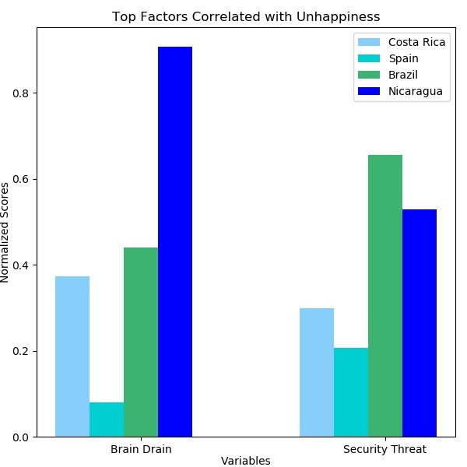
Question 5
How do our outliers look on these happiness variables?
Variables: (we need to pick 3-5 that are interesting)
Outlier countries

Slide 14
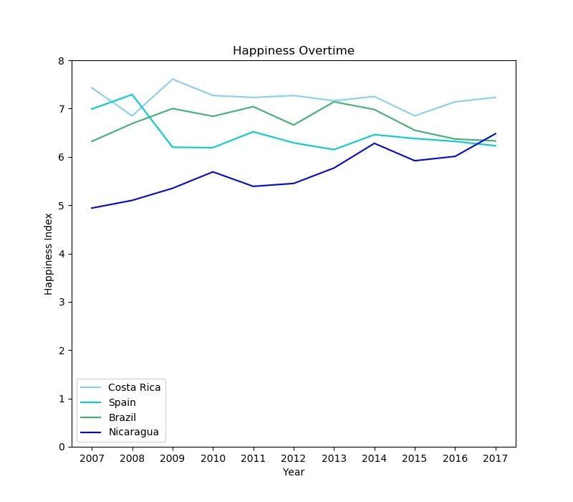
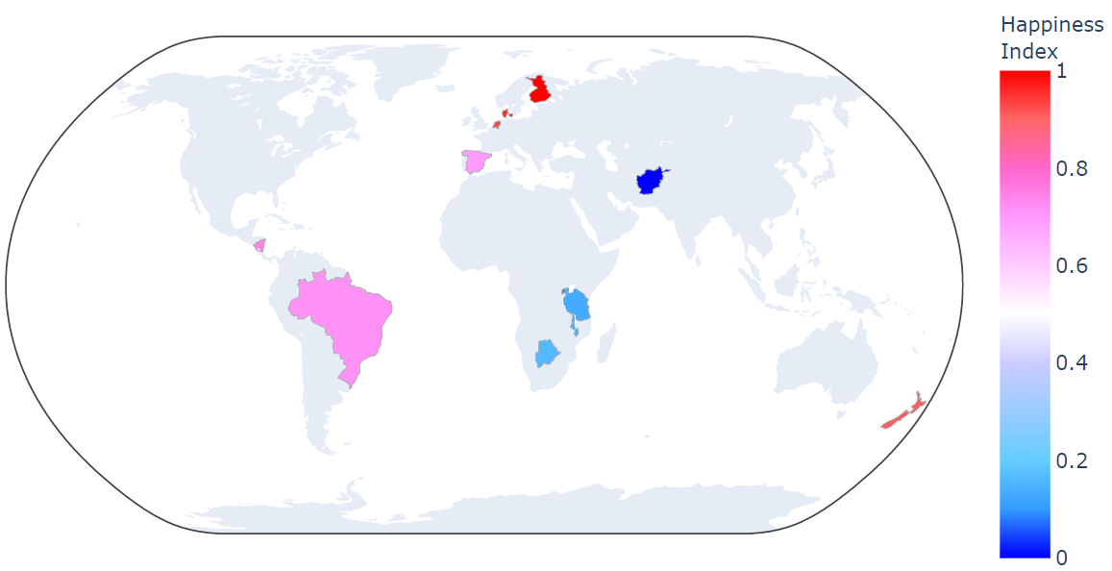
Question 6
Have these countries (outlier (poor but happier) happy countries) always been happy?

Slide 15
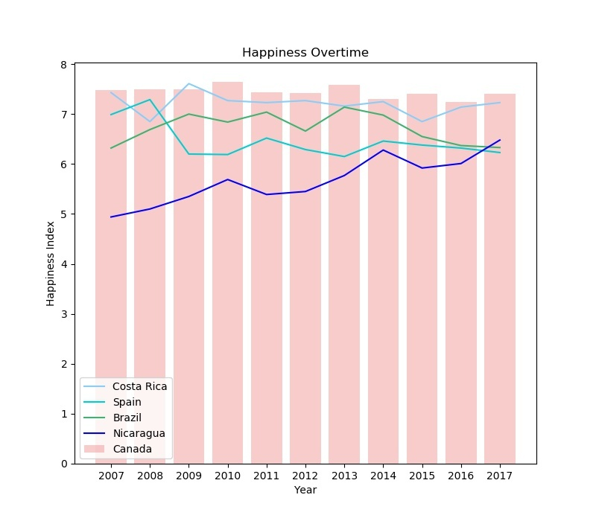
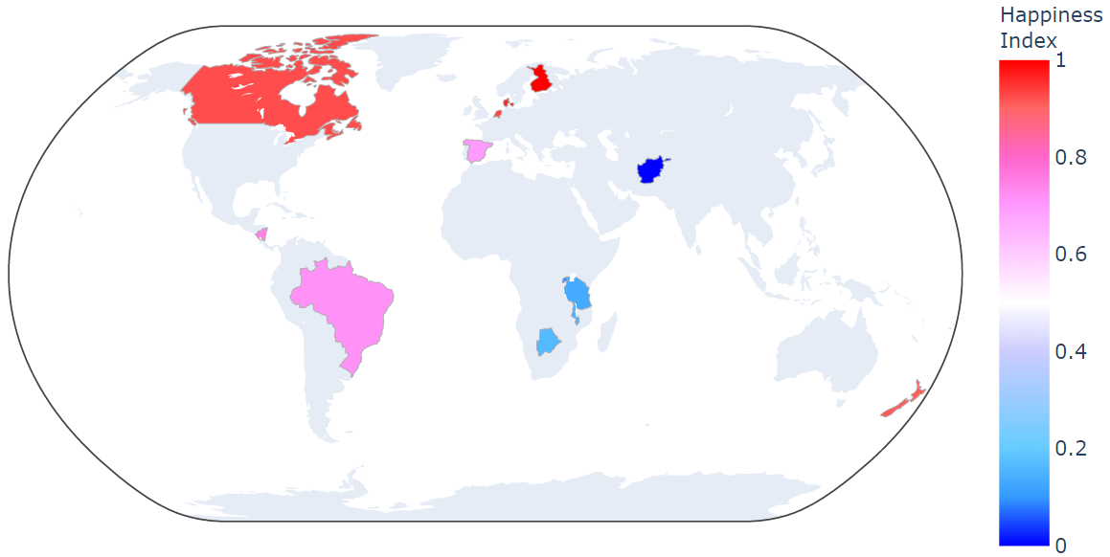
Question 7
How does Canada compare?

Slide 16
Conclusion: money doesn’t necessarily buy happiness, but it helps
Need: repeat of slides 12-13 for Canada

Slide 17
PRE-WORK, ExPLORATION & data cleaning findings:
Do we have available datasets required for our topic? – Yes
Are the datasets fairly manageable when cleaning the data? – Yes
What’s our narrative? How do we pitch our narrative/topic to our audience better?
How can we leverage our datasets to produce meaningful analysis that will matter today or next years? Or to what people care nowadays ☺
& something we can continue using for our next projects
How do we not lose focus or how can we re-align the variables/indicators that we already have, in order to back up our narrative specific to this project (for now).
Maybe we need to seriously take into consideration Ahmad’s feedback during the planning stage – “it’s kinda dark” topic to work with

Slide 18
Challenge:
Outdated
Suicide Dataset
( 90s- 2017)
Very Recent
World Happiness Dataset
(2015 – 2020)
Google Trends / Searches / Articles
Correlation
Algorithm
Prediction/Forecast
Visualization
vs
vs
2-3 year gap
Year
Country
Prevalence Rates
Suicide Rate
Depressive Disorder
Year
Country
Happiness Score / Rank
Economy GDP per capita
Family
Health & Life Expectancy
Freedom
Generosity
Trust in Government/ Corruption
Dystopia Residual
Google searches
Interest over time

Slide 19
Proposal:
World Happiness
Report Dataset
(2015 – 2020)
Google Trends / Searches / Articles
(2015 – 2020)
Correlation
Algorithm
Forecasting/Prediction
Visualization
Narrative Summary
vs
Year
Country
Happiness Score / Rank
Economy GDP per capita
Family
Health & Life Expectancy
Freedom
Generosity
Trust in Government/ Corruption
Dystopia Residual
Google searches
Interest over time
Year
Country
Searches
Suicide
Recession
Divorce
Death
Protest, etc
Unique / + – Happiness Score Distribution
Bar – Google Searches (mean)
Pie – Happiness Indicator Distribution
Line – Happiness Score & Rank / time
Line – Google Search / time
Scatter Plot – correlation between Happiness & Google search
Box & Whiskers – for outliers
Regression Line Plot –how strong/weak/+/-
Heat Map – Happiness per Country & Google Searches
Geolocation Mapping
Suicide Prevention Help Centres
NGOs, Distress Centres, YMCA etc
Next Project: Machine Learning – Forecasting/Prediction
Health / Death (See google trends)
CSV
API – 2012-2014
CSV
API

Slide 20
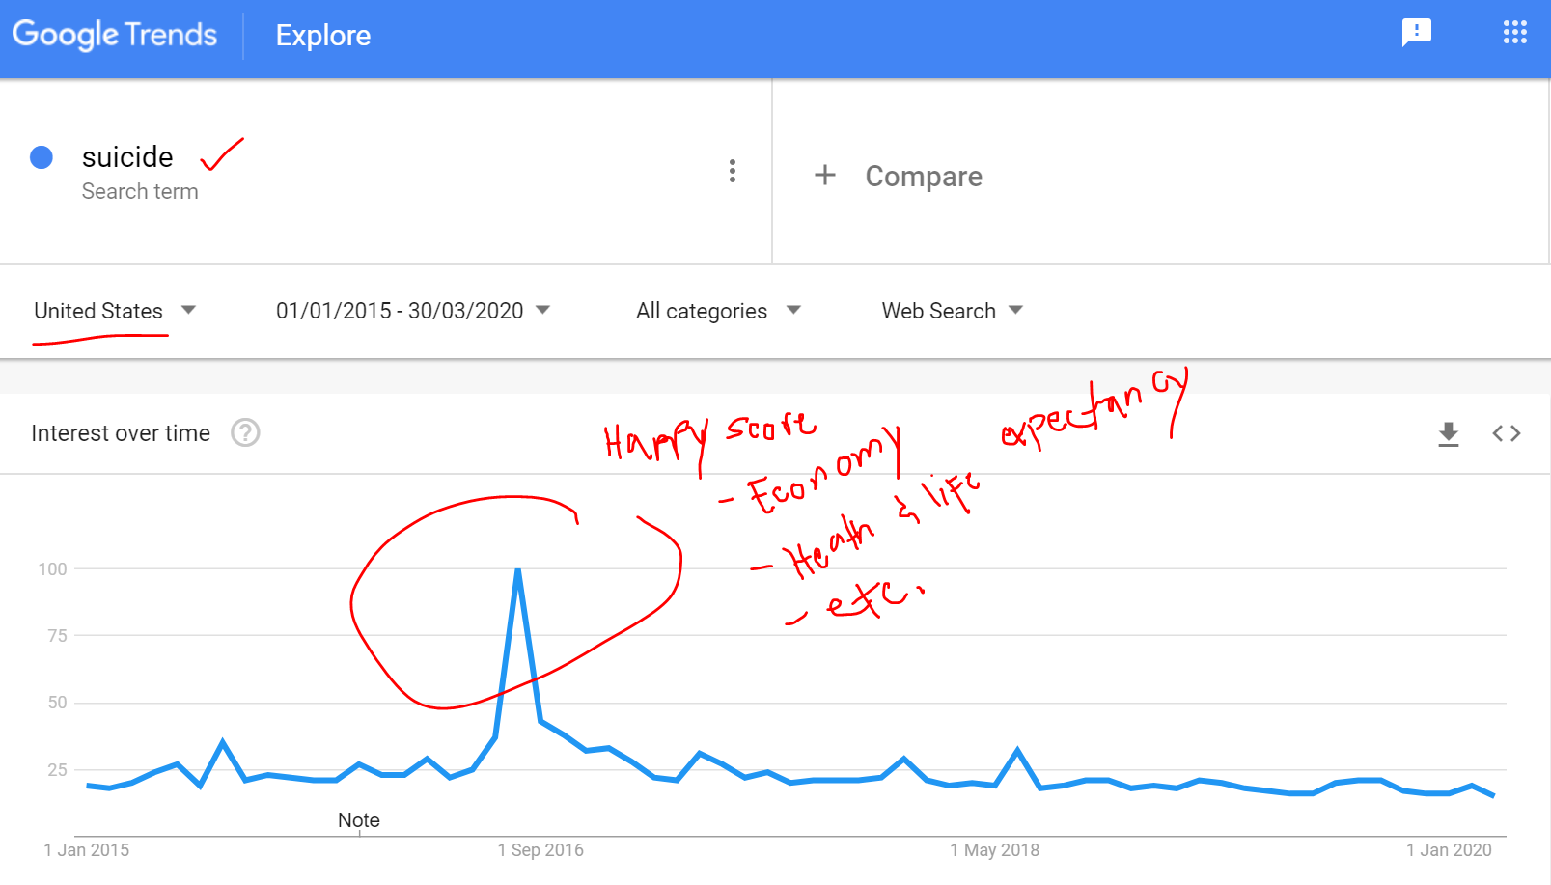

Slide 21
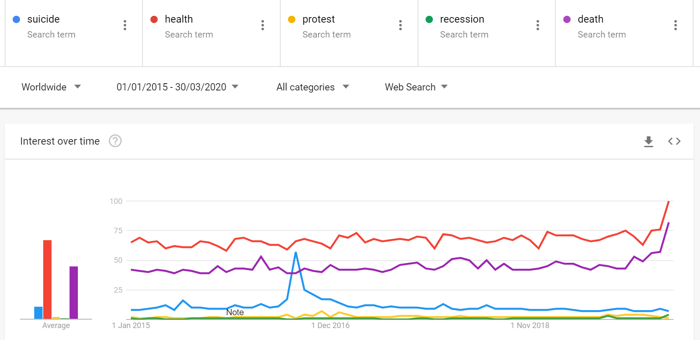

Slide 22

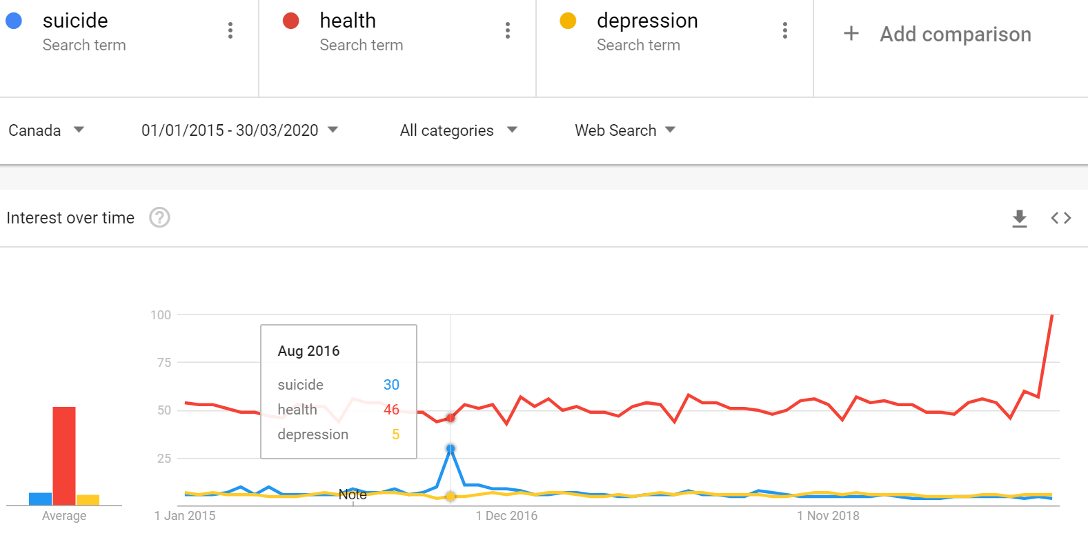


Slide 23
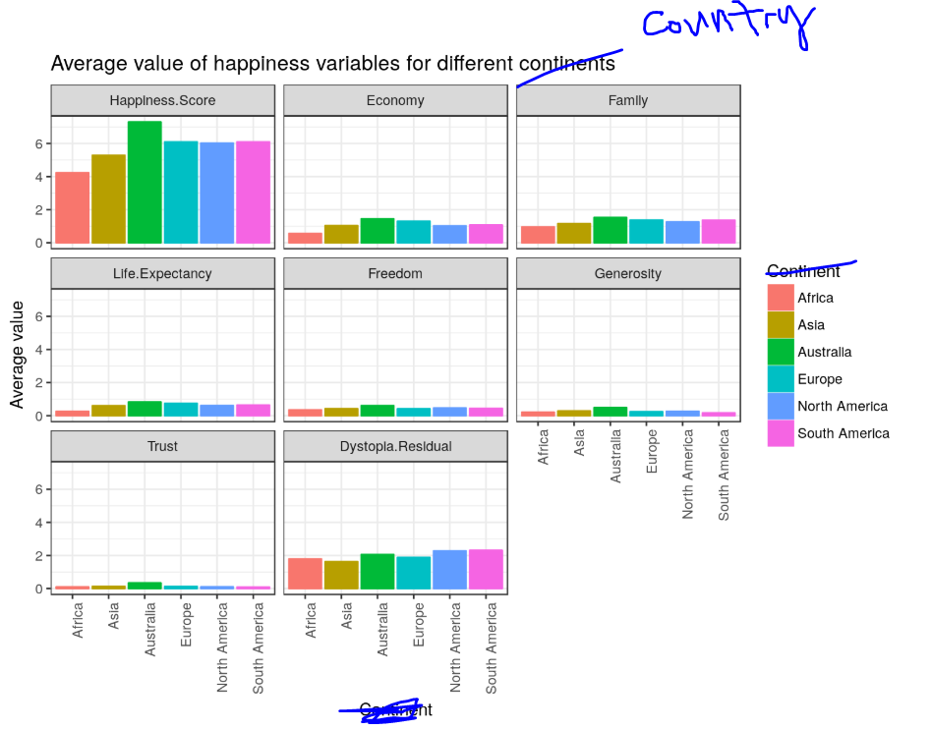

Slide 24
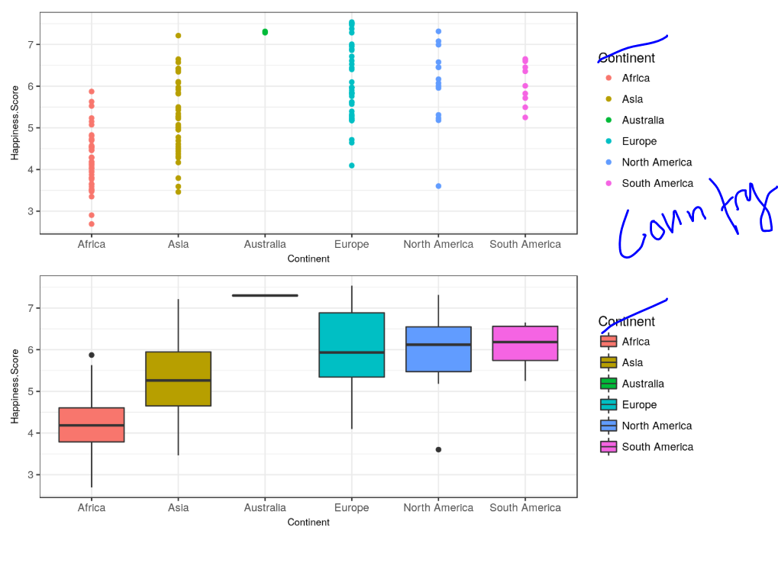

Slide 25
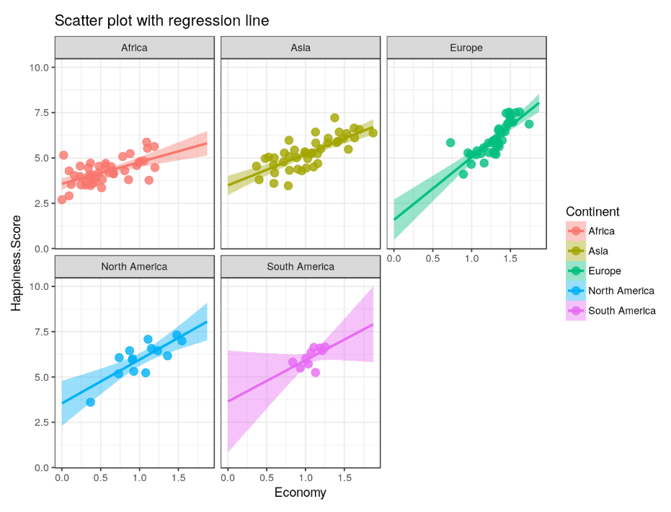

Slide 26
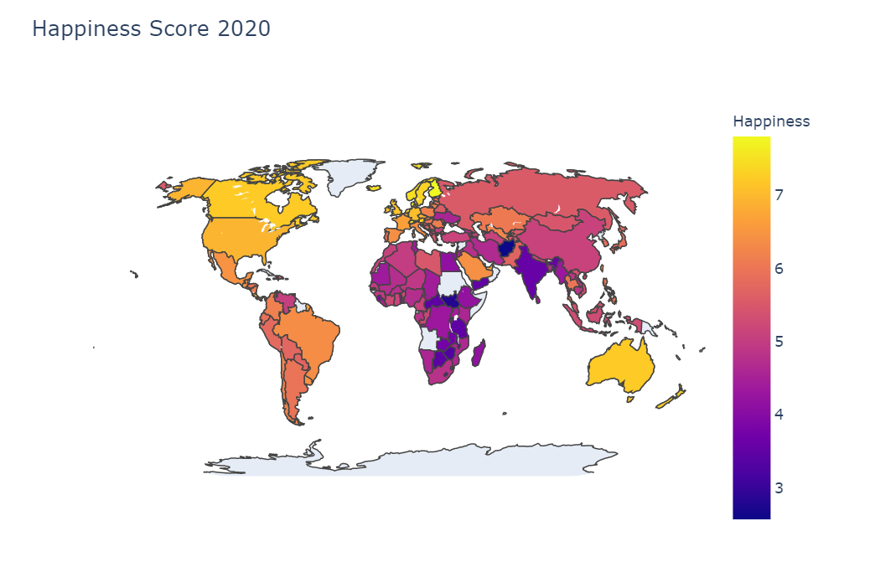

Slide 27
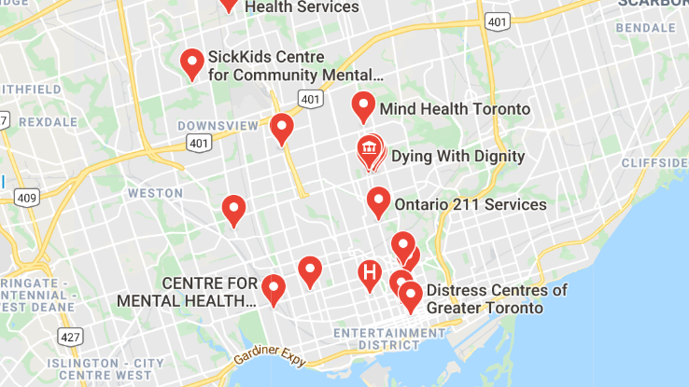

Slide 28
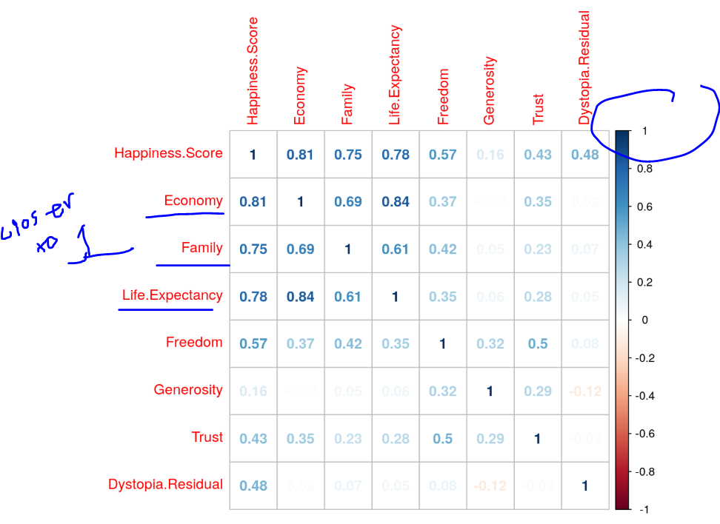
Unique approach to visualizing Normal distribution

Slide 29
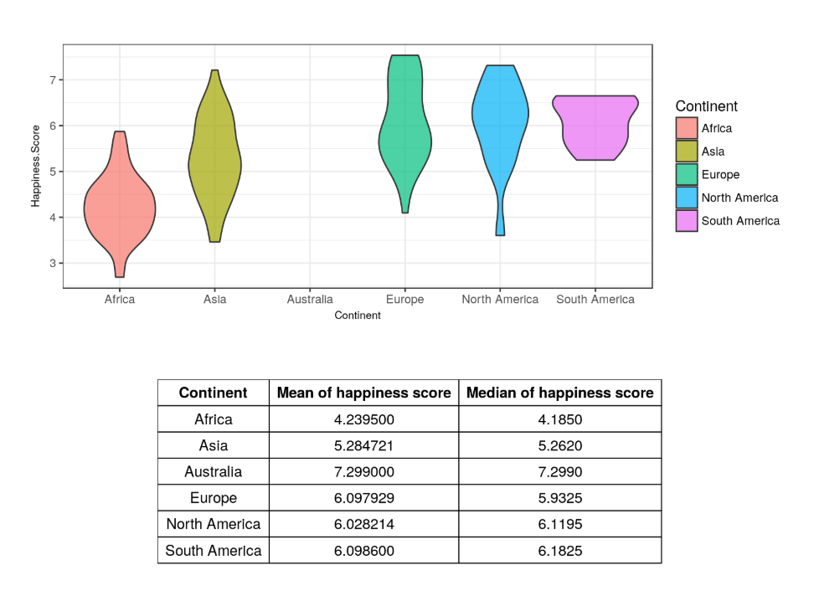
Unique approach to visualizing Normal distribution

Slide 30
Questions? Or let’s go back to these:
What’s our narrative? How do we pitch our narrative/topic to our audience, better?
How can we leverage our datasets to produce meaningful analysis that will matter today or next years? Or to what people care nowadays ☺
& something we can continue using for our next projects
How do we not lose focus or how can we re-align the variables/indicators that we already have, in order to back up our narrative specific to this project (for now).
What countries to include? (Let’s come up soon pls & just update it after)
Decide what variables or key indicators to use for analysis? (all or limited to…?)
Timetable for our outputs
June 24
July 4 – Polishing and Presentation Prep
July 7 - Presentation

Slide 31
